Slide 1
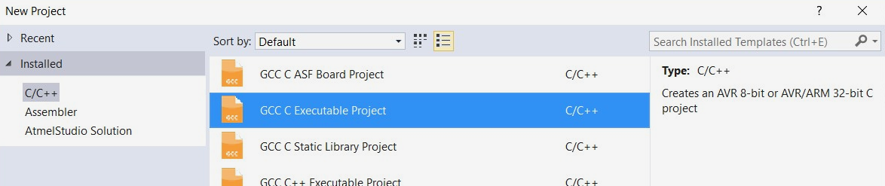
C Project
Ensure you select the ‘GCC C Executable Project’ type
This will matter in later weeks as we start to interface with more complex subsystems of the lab board
Notes:
Just in case I’ve told you all to use the C++ libraries!

Slide 2
Multiplexer
Parallel Port A is Multiplexed
  Allows us to connect multiple sources to a single port
PE1/PE0 control the Multiplexer
  Setup the Multiplexer in your Setup function, setting PE1/0 to the appropriate levels based on the problem
// Setup Toggle Switches
void setup(void) {
DDRE = 0b00000011;
PORTE = 0b00000000;
}
💡 See Appendix C (Lab Book Pg. 49) for more information about the Multiplexer
Notes:
The last two numbers of PORTE should change based on the input required in the problem given.

Slide 3
Delays
Define the CPU Frequency
  #define F_CPU 8000000UL – Define before calling the include
Include the Delay header file
  #include <util/delay.h>
Call the function in your code
  _delay_ms( {time} );
// Ex. Toggle Light @ 5Hz
#define F_CPU 8000000UL
#include <util/delay.h>
int main(void)
{
setup();
while(1) {
toggleLight;
_delay_ms(100);
}
}
💡 Delays are briefly covered on Pg. 12 of the Lab Book

Slide 4
State Machines
State Machines use distinct States
  Each state should reflect a different output state on the microprocessor
State Machines will navigate to the state ‘expression’ each time it is run
  Ensure ‘expression’ is defined outside of the switch and the while(1) loop
  Otherwise, the value will reset every time!
The ‘switch’ will keep running the current case until ‘expression’ has changed to a different value
  Ensure each state has a way of exiting to another state.
// Example State Machine with two States
#define firstCase 1
#define secondCase 2
int expression = firstCase;
int main(void)
{
setup();
while(1)
{
switch (expression)
{
case firstCase:
/* code to run in this
state */
/* check conditions to see if
state should be switched */
break;
case secondCase:
/* code */
break;
}
}
}

Slide 5
State Machines
// Example State Machine with two States
#define firstCase 1
#define secondCase 2
int expression = firstCase;
int main(void)
{
setup();
while(1)
{
switch (expression)
{
case firstCase:
/* code */
break;
case secondCase:
/* code */
break;
}
}
}
// State Machine adapted to use If Statements
#define firstCase 1
#define secondCase 2
int expression = firstCase;
int main(void)
{
setup();
while(1)
{
if (expression == firstCase)
{
/* code */
}
else if (expression == secondCase)
{
/* code */
}
}
}
Notes:
The state machine can be thought of almost as just a large ‘If’ tree (if this makes it any clearer)

Slide 6
Example State Machine
Problem 4 – Reaction Timer:
The reaction timer tests the reaction time of two opponents. The game begins when the start
button is pressed, then a buzzer will sound in a random time frame between one and five
seconds. The two users will respond to the sound of the buzzer by pressing their respective
buttons. The person who presses their button first after the buzzer sounds will win, indicated by
their associated light coming on for three seconds and then their reaction time displayed on
PORTC. The game will begin again when the start button is pressed.
Notes:
Example for Problem 4 – Reaction Timer
The hidden slides at the end of the PPT could be helpful if you don’t understand the description!

Slide 7
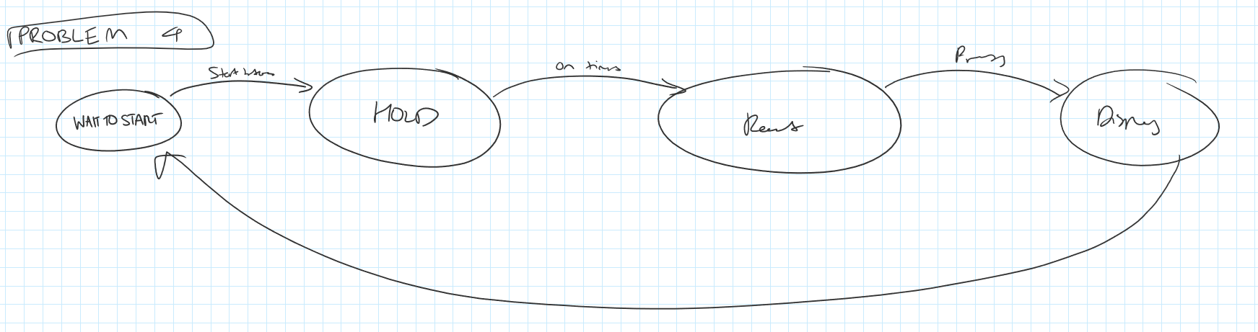
Example State Machine
Problem 4 – Reaction Timer
Notes:
Example for Problem 4 – Reaction Timer
This is just a rough diagram that shows some thinking I did before I started the problem (excuse the handwriting – I know it’s terrible).
As I have mentioned, it’s ideal to do the structure/state diagram first.
However, if you can’t, try at least draw out the problem into something a bit more code-oriented before writing the code!

Slide 8
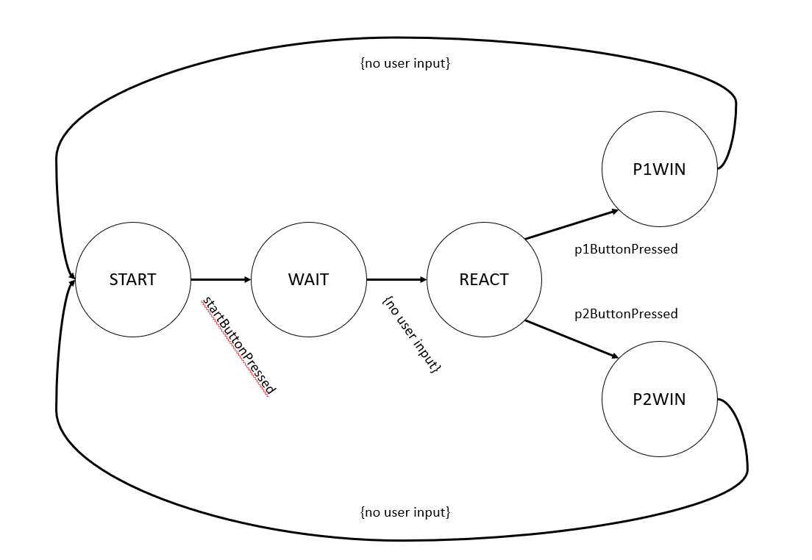
Example State Machine
Problem 4 – Reaction Timer
Notes:
Example for Problem 4 – Reaction Timer
The final diagram.
There are actually several ways of doing this problem, this is just the method I used!
Can use PowerPoint + Shapes, or (neatly) draw out a diagram on paper and submit this with your assignment!

Slide 9
Timers (A Brief Introduction)
4 x Timers on the AT90USB1287
  2 x 8-bit and 2x 16-bit timers
  Timers are covered later in the course – for this lab, just understand they exist
Use the timer to generate a ‘random’ number
  The number isn’t truly ‘random’
  Setup the timer in your setup function
  Get a random number using the TCNT0 register
// Example to setup and call Timer 0 to obtain a random number
int main(void)
{
int randomNumber;
setup();
while(1)
{
/* code */
randomNumber = TCNT0;
}
}
void setup(void)
{
// Setup TCCR0B - 0x01 == 0b00000001. This
will start the timer.
TCCR0B = 0x01;
}
Notes:
This wasn’t needed as it was only used in Problem 4 – Reaction Timer

